Slide 1
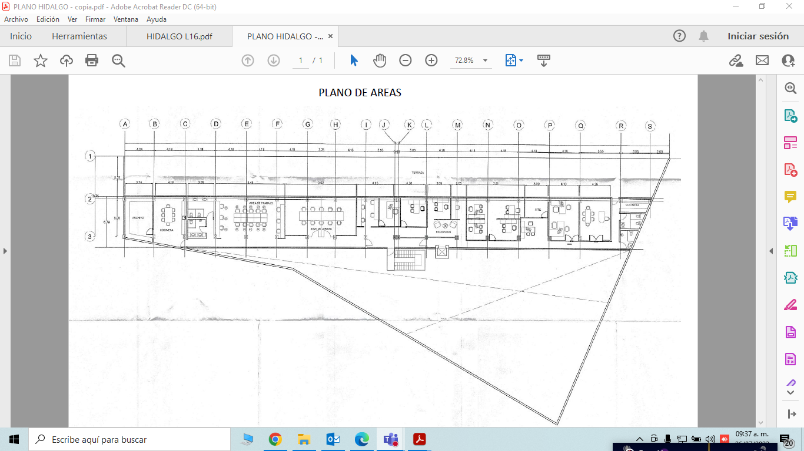
PLANO HIDALGO 9 LOCAL 17-2

