Slide 1
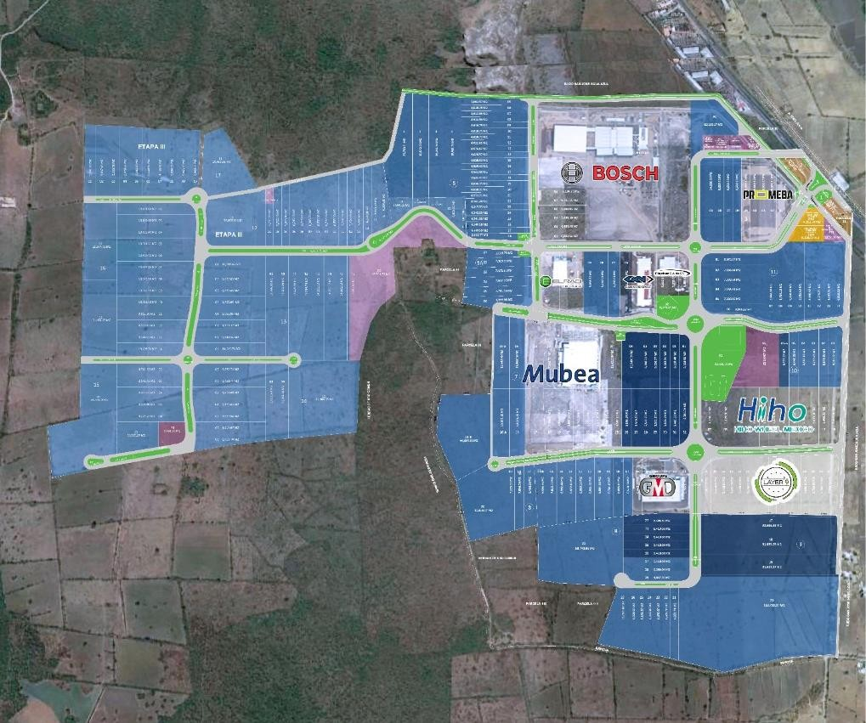
1.95/2.73/2.84/3.60/4.26/9.06 HA
Oportunidad de Inversión en Guanajuato en Parque AAA con toda la infraesctructura:
Venta (USD): $48 x m2
98.42 Ha
90.77 Ha
71.77 Ha
- Available Land Phase I and II
- Available Land Phase III
- Sold Land
- Commercial Land
- Infrastructure Area
- Green Area
23.51 Ha
*El parque construye la bodega adecuándose a tus necesidades.

Slide 2
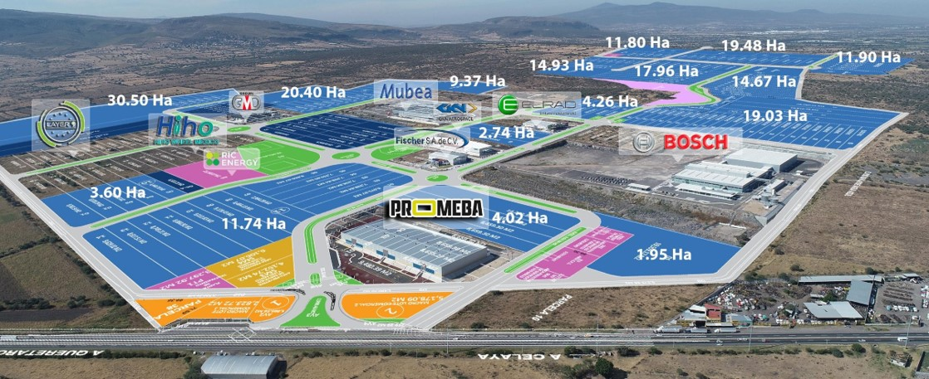
1.95/2.73/2.84/3.60/4.26/9.06 HA
TELECOMMUNICATIONS
Underground ducts for fiber optics and copper wiring.
Main provider TELMEX®.
24 hrs/7 days a week /365 days a year service at main gateways and throughout the Industrial Park. Surrounding chain link fence overall the Industrial Park.
PUBLIC LIGHTING
LED lamps properly spaced based on lighting design in common areas.
NATURAL GAS
Available in Amistad Chuy Maria Industrial Park.
To be provided by INDUGAS based on customers
requirements.
LANDSCAPE
Landscape designed common areas.
COVENANTS, CONDITIONS & RESTRICTIONS
Enforced by park owners association.
CLIENTS
Mubea
Fisher
GMD
Elrad
BOSCH
GKN
Hiho Wheel
Promeba
Layer 9

Slide 3
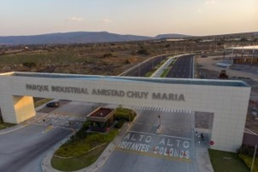
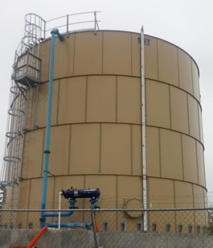
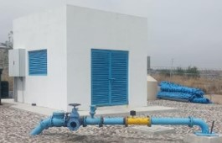
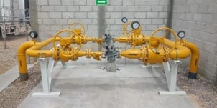
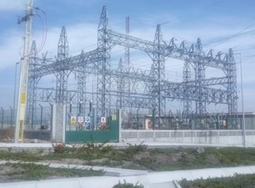
1.95/2.73/2.84/3.60/4.26/9.06 HA

Slide 4
1.95/2.73/2.84/3.60/4.26/9.06 HA
DISTANCE TO / DISTANCIA A
IMPORTANT CITIES
León
Silao
Guanajuato
Salamanca
San Miguel de Allende
Querétaro
MN
70
70
90
40
65
50
US$ 48 EN VENTA M2
Disponible/Available:
Mapa
de
ubicación

